Slide 1
The Communication Process

Slide 2



Goals
What is Formal and informal Communications
Describe 4 Communication Channels
Using Brainstorming Sessions as a form of communication

Slide 3
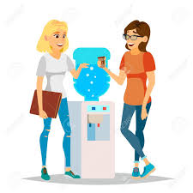
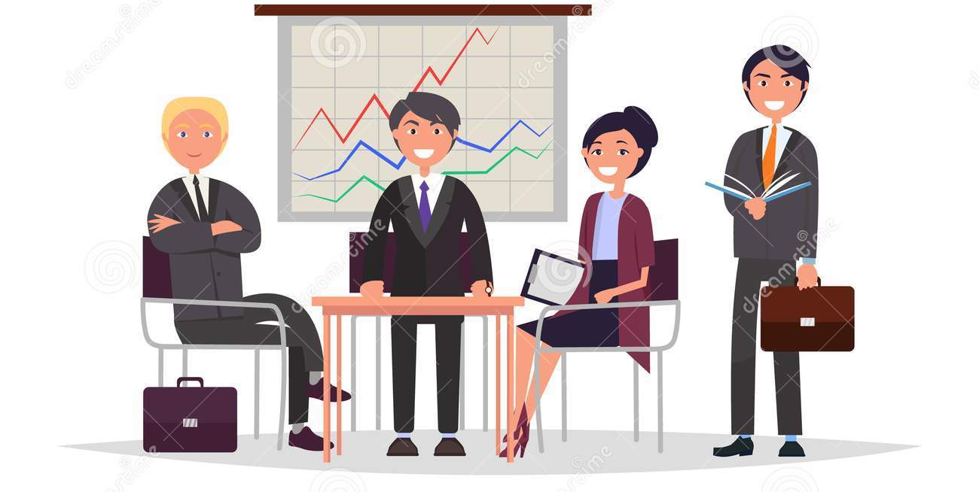
Formal Vs Informal communication
Formal Communication
Informal Communication
the exchange of official information – work related matters
Well thought out and planned – takes time to convey
flows along the different levels of the organizational hierarchy (up, down, across)
Follows rules, policy, standards, processes and regulations of the organization
Casual and often unofficial communication
Unplanned messages – personal matters or business reminders
Fast and time savings
information is exchanged spontaneously between two or more persons
Does not conform to the
official rules or processes

Slide 4

Managers Spend 2/3 of their day Communicating
Communication is vital in running an organization and provides a link between employees and customers and between employees and manager.
Managers Communicate in 4 ways:
  Speaking
  Listening
  Writing
  Reading

Slide 5
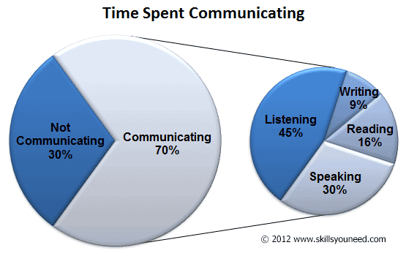
How Managers Communicate

Slide 6


What is meant by media
Forms or channels of how we communicate
Media - communication outlets or tools used to store and deliver information
Also known as medium or mediums (multiple)
AKA: Channel Management

Slide 7

Think about it: You are working in a restaurant. You have a new low-fat menu item that is not selling well. What channel management decisions (media) would you make to increase sales on this product?

Slide 8
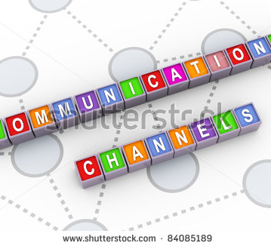
Four Channels of Communication
Channels of communication – the means by which the message is conveyed
Oral Communication
Written Communication
Nonverbal Communication
Electronic Communication

Slide 9

Oral Communication
Discussion Topic : Oral Communication:
  In groups of 4, brainstorm for 2 minutes and list as many forms of oral communication employees/managers will engage in that you can think of?
Complete the Group Discussion Form as you discuss (will be handed in)
Select a Reporter: Select the person who has the most siblings.
Share your Ideas (instructor will add your ideas below)

Slide 10

Oral Communication
Phone calls
Meetings – group or individual
Presentations
Group Brainstorming activities
  Brainstorming: group discussion technique used to generate as many ideas as possible
  Focus Groups: group interview involving a small number of similar people
Providing instruction on tasks/duties
Formal – prepared and structured meetings
Informal discussions – happens by chance

Slide 11

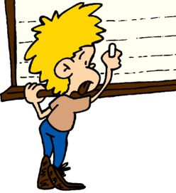
Written Communication
Topic : Written Communication:
  In groups of 4, brainstorm for 2 minutes and list as many forms of written communication methods employees/managers will engage in that you can think of?
Complete the Group Discussion Form as you discuss (handed in)
Select a Reporter: Select the person who is the oldest.
Share your Ideas (instructor will add your ideas below)

Slide 12
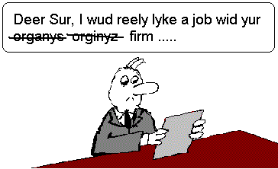
Written Communication
Letters
Emails
Reports
Proposals (written report)
Memos
Invoices
Pictographs (image messages)
Faxes
Bulletin Boards
Messages
Newsletters
Employee Manuals – Policy Manuals, employee handbooks etc.
News Release
Flyers/Announcements

Slide 13


Google Assignment Discussion
From our assignment where an employee said something as a joke but was inappropriate.
What method would you communicate it?
How Should I send this?
What does the supervisor mean?

Slide 14
Google Classroom Assignment
Congrats on getting employee of the month, you worked very hard and deserved it! Thank you for being a great employee.
Congratulations Jerry, you’ve worked very hard.
Congratulations on the new position, we love you hard work and effort and we appreciate all you’ve done for us!
Congratulations Tom on employee of the month. You deserve it keep working hard.
Congrats, on the fine work, keep on working hard and prove why you earned it.
Congratulations sir!! I’m glad to see your doing great. Keep it up!
Congratulations Tim, you deserved it!
Hey, congrats on getting employee of the month. But make sure you humble your self and keep working and maybe we’ll talk about a raise or promotion in the future.
Congratulations on getting employee of the month! You worked hard during the last month and you deserve it. Keep working hard!
Congratulations! You have received employee of the for the month of January. Your passion really shows through in your everyday work. You have gone above and beyond the past few months and this award is very much deserved. Have a great rest of your day!
Congratulations on winning employee of the month. All your hard work shows and it is appreciated. Keep it up.
You have worked hard for us this last month so I’ve decided to give you employee of the month congratulations you earned it! I’ll have your reward on Monday.... have a great weekend.

Slide 15
Google Classroom Assignment - Negative
This action shall not be tolerated
Hey. Where we work is a place where we do not fight so settle your differences or one of you will have to go
Dear Teagan, I would like you to not use that tone or manner when talking to Charlie . I know it wasn’t put in that intent but it came across as disrespectful so could you please be careful for that.
Hey Ashton you cannot be saying these kind of words in the work space even if it is a joke
That name you said is very uncalled for in this professional setting. Please refrain from using that language. If you do again you will not get off this easy.
Hey I heard you make a rude comment today. I know it might of been a joke but keep it for outside of work.
Those words you used earlier were not words to be using in a work place. Please and thank you.
We have a case of harassment in the work place regarding you. If further behavior continues we will have to re-evaluate your contract
Responses Communication Assignment Responses.xlsx

Slide 16
How to Write an Effective Communication
Subject clearly catches their attention – What your message is about
Opening - Since this is a friendly reminder, it's a good idea to start the message on a positive note. This keeps your message from seeming too harsh. If you can't think of anything specific, state something friendly like "I hope you are doing well."
Body of the Message - This is where you need to communicate the purpose of the message. Think carefully about what you want to say here. Be as clear as possible. Explain exactly what is overdue or what needs to be addressed (work, behavior, timeliness, etc.). Explain the impact, the effect, or the results of not doing or doing the behavior
Closing: Call to Action - Finally, tell the message recipient what you'd like them to do. Usually, this is a request for them to perform a desired action—It's also a good idea to offer help, such as an offer to answer questions.

Slide 17
Memo Format Assignment
Handed out the Packet

Slide 18
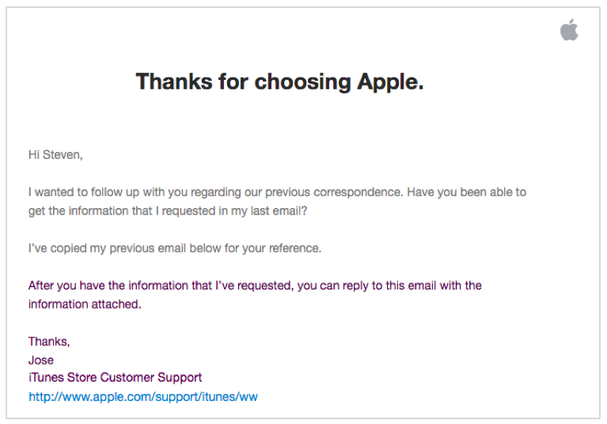
When to use emails
Emails - most common form of communication in business
  Used both within an organization and outside
  For fast, temporary communications that readers quickly read, act on, and delete
    Speedy updates, short reminders or check-ins, time-sensitive announcements, and similar short-lived messages
  Use a Catchy Subject line
  As always, needs an Introduction, a Body, and a Closing
  Always have a greeting (salutation) and closing
    Salutation (greeting) less formal: Hello Nate or Nate
      Do not use slang such as Yo Nate
    Closing can be sincerely or just Thank you and followed by your name, organization, and title
If possible, limit email length to what appears on screen
Use one blank line between paragraphs to avoid “Wall of Text” Syndrome

Slide 19
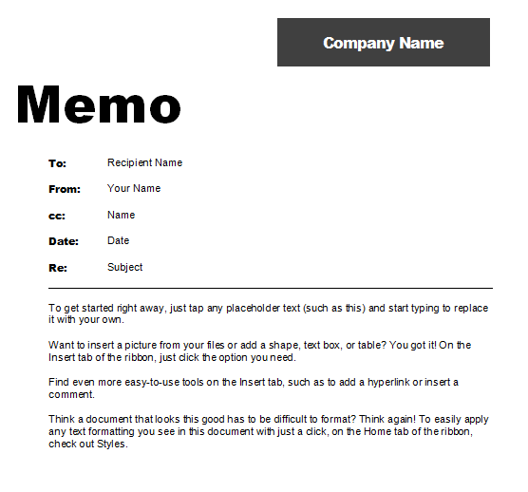
When to use memos
Communication within an organization
For proposal, a serious recommendation, a technical explanation, a new policy, or something that readers will consult more than once
Will be printed and posted on a bulletin board
If contains bullet points, bold headings, columns, tables, or graphs
Use a Cathy/specific Subject line
As always, needs an Introduction, a Body, and a Closing paragraph
Try to keep is short with ½ page
To send your memo, simply attach it to a brief email.

Slide 20
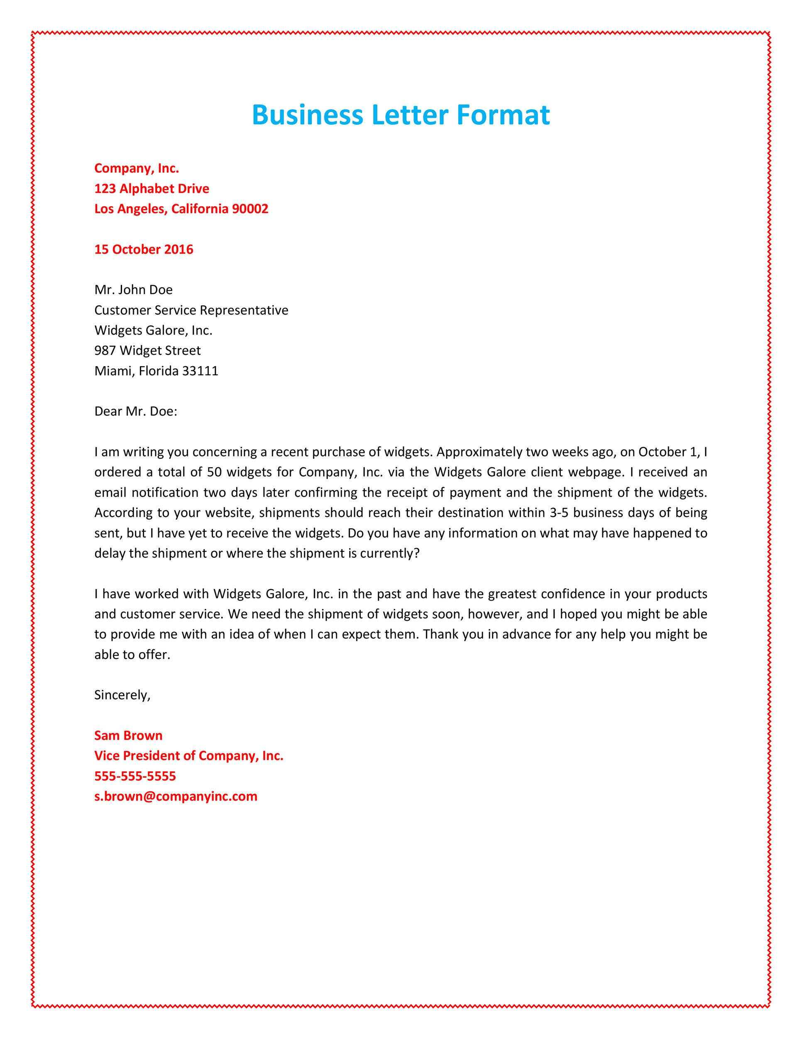
When to use letters
Letters are typically sent to recipients outside an organization
May be used within an organization if the topic is very formal and/or non-routine
  Ex: written warning in an employee’s file
Often sent to a company, its clients, employees, or stakeholders
Serious and formal types of correspondence
  Reference letters
  Employment verification
  Job Offers
  Contracts
Includes a greeting Salutation
  Dear Mr. Smith
As always needs an Introduction, a Body, and a Closing to the body of the letter
Formal Closing: Sincerely
Name and contact information

Slide 21
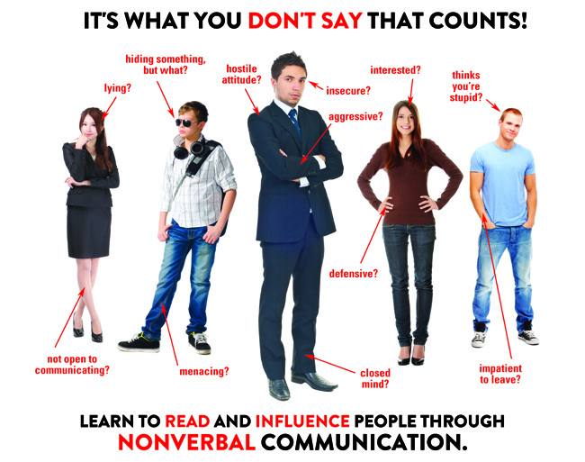
Non-Verbal Communication
Topic : Non-Verbal Communication:
  In groups of 4, brainstorm for 2 minutes and list as many forms of non-verbal communication methods employees/managers will engage in that you can think of?
Complete the Group Discussion Form as you discuss (handed in)
Select a Reporter: Select the person who is the youngest.
Share your Ideas (instructor will add your ideas below)

Slide 22

Non-Verbal Communication
Body Language
Posture
Frown
Hand movement
Tone
Body movement
Eye/No eye contact
Clothing

Slide 23
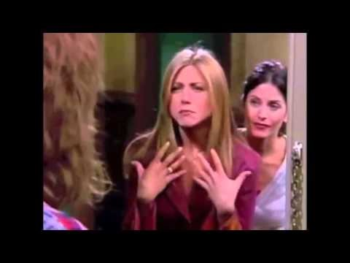

Slide 25

Electronic Communication
Electronic can be verbal, written, or nonverbal
Topic : Electronic Communication:
  In groups of 4, brainstorm for 2 minutes and list as many forms of electronic communication methods employees/managers will engage in that you can think of?
Complete the Group Discussion Form as you discuss (handed in)
Select a Reporter: Select the person who talks the most.
Share your Ideas (instructor will add your ideas below)

Slide 26

Electronic Communication
Electronic can be verbal, written, or nonverbal
Social media
Texting
Digital pagers
Voice mail
Teleconferences
Videoconferences
Instant messages
Web Pages
Pod Casting
Videos
Webinars
Blogs

Slide 27
